Slide 1
Summary
At 0.1K/min, each run takes 3 days.
Conducted blank and 0wt%
8wt% finishes Friday
A pretty short meeting

Slide 2
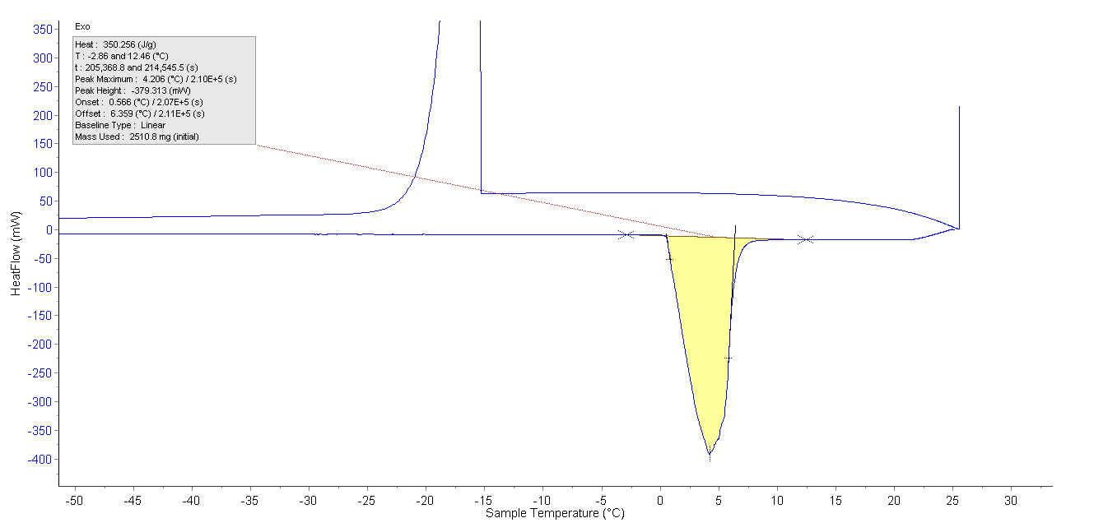
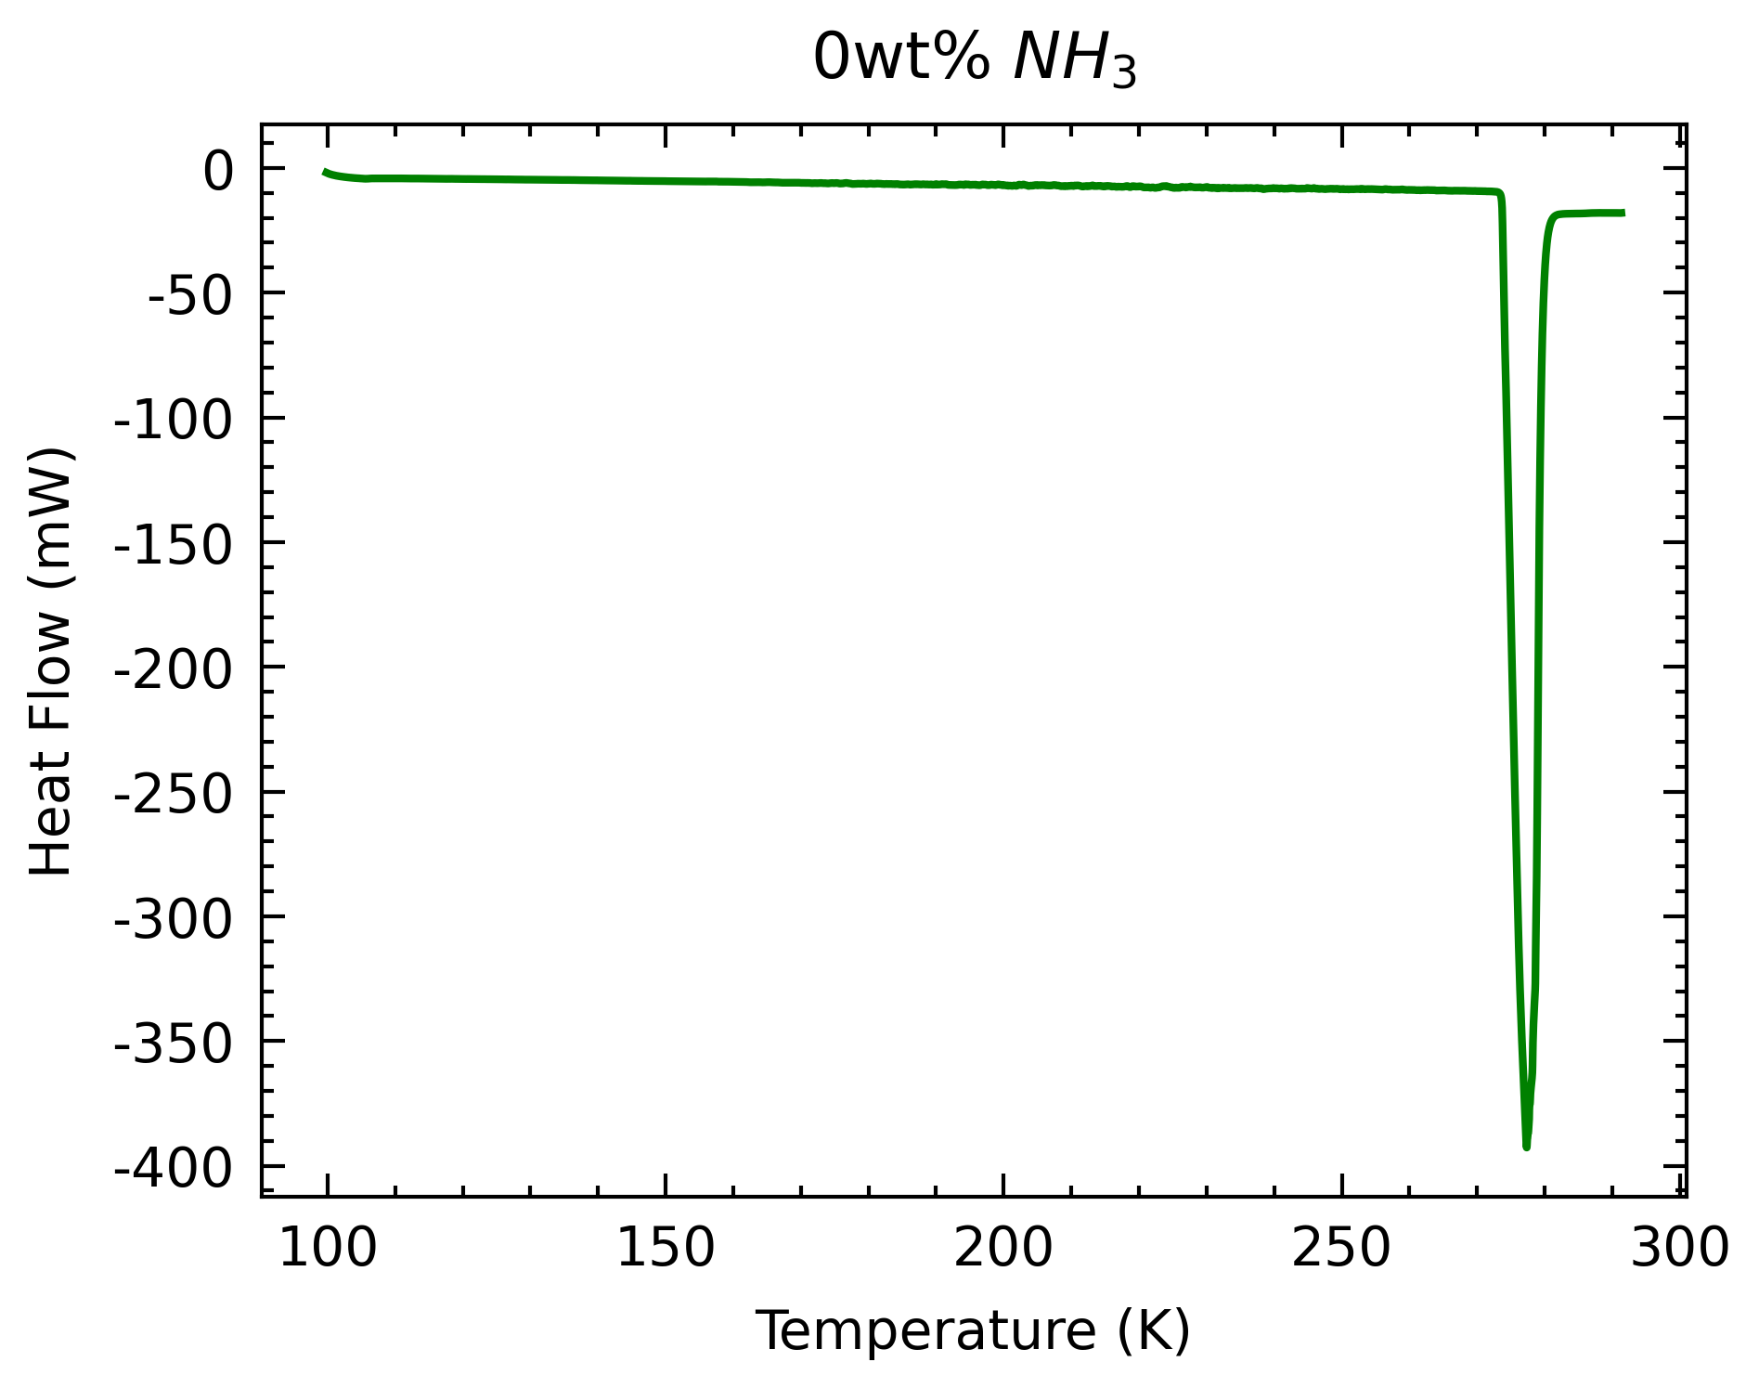
0wt% run
0wt% went smoothly and as expected
Onset T within 1K of expected melting point

Slide 3
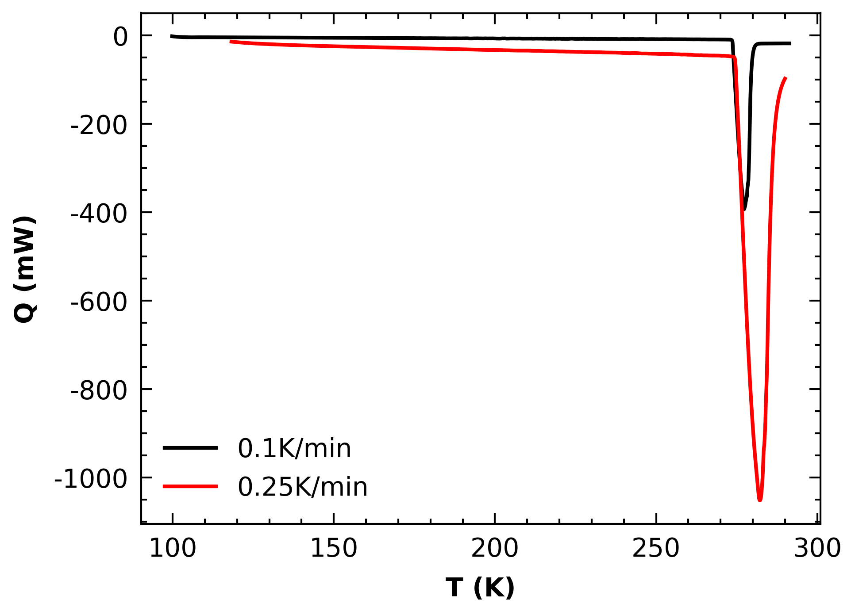
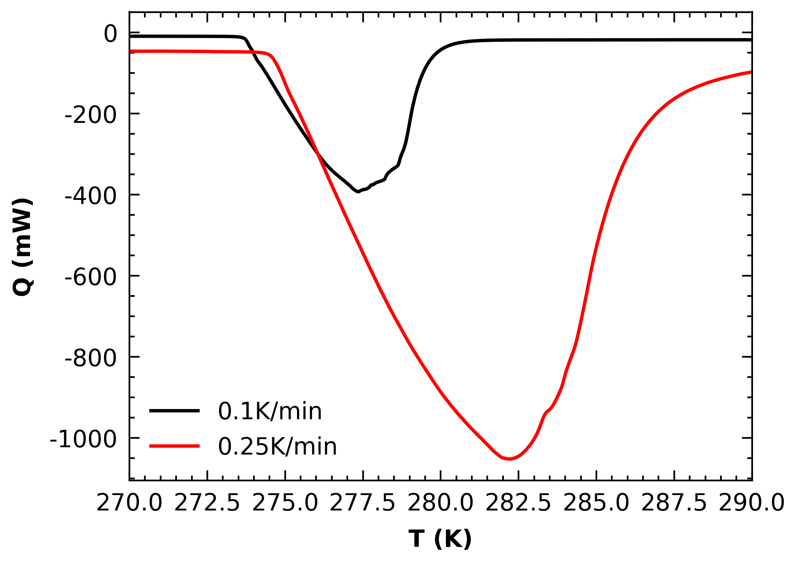
0wt% comparison
2.5mL vs 5mL
0.1K/min closer to melting point
Will check onset for 0.25K/min on Friday
Visually, it is higher (~275K)
Ramp Rate | Onset T | Offset | Peak T | Offset
0.1 | 273.72 | 0.57 | 277.36 | 4.21
0.25 | - | - | 282.20 | 9.05

Slide 4
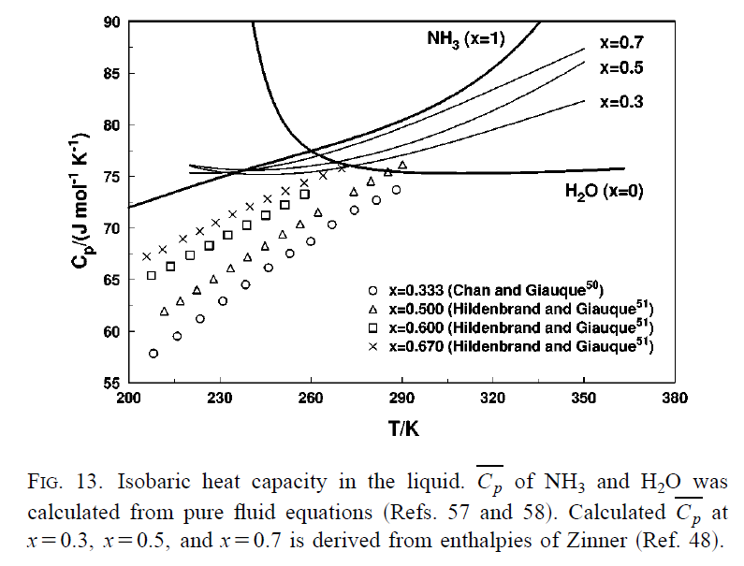
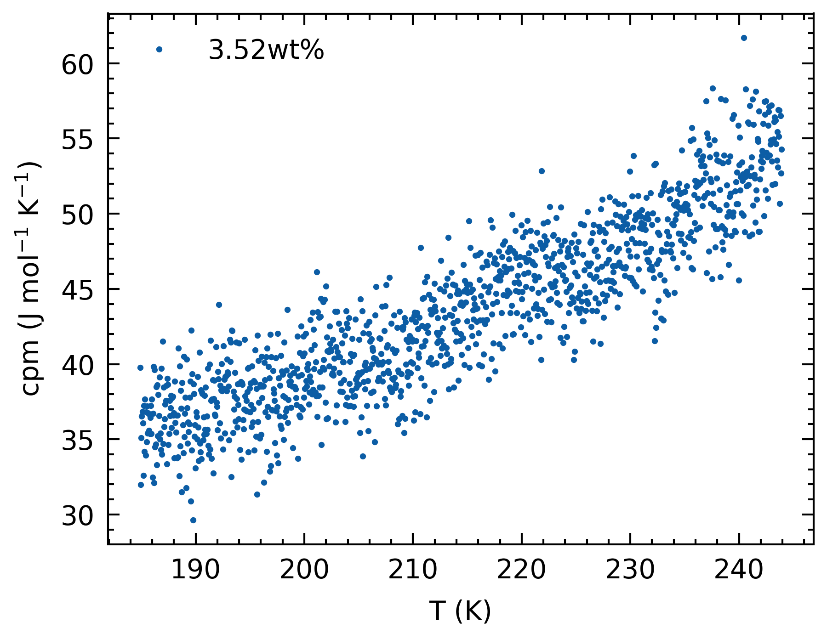
Quick molar specific heat comparison
Quite a bit lower, somewhat follows Giauque’s trend (lower X)
For Tillner-Roth and Friend’s use case, Zinner provided a better fit for their EoS.
Tillner-Roth & Friend, 1998

Slide 5
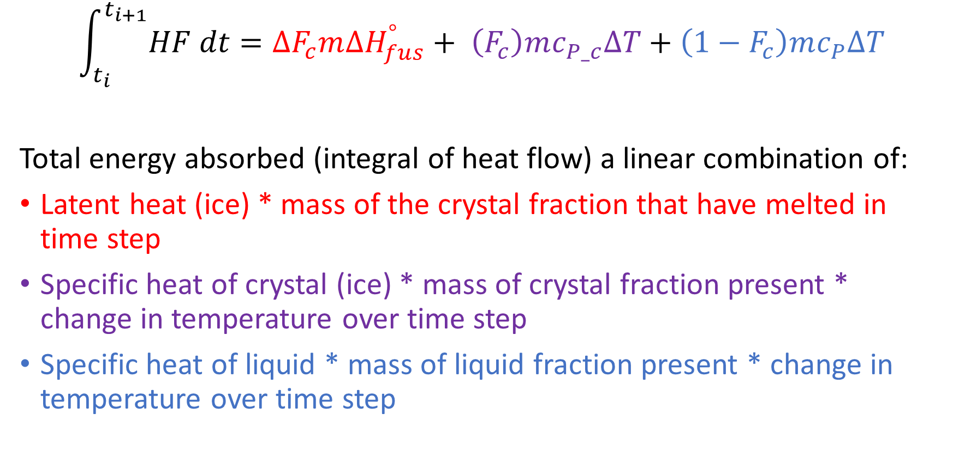
Specific Heat Retrieval
$$\int_{t_{i}}^{t_{i+1}}{HF dt}=∆F_{c}m{∆H}_{fus}^{°}+ \left(F_{c}\right)mc_{P_c}∆T+\left(1−F_{c}\right)mc_{P}∆T$$
Total energy absorbed (integral of heat flow) a linear combination of:
Latent heat (ice) * mass of the crystal fraction that have melted in time step
Specific heat of crystal (ice) * mass of crystal fraction present * change in temperature over time step
Specific heat of liquid * mass of liquid fraction present * change in temperature over time step

Slide 6
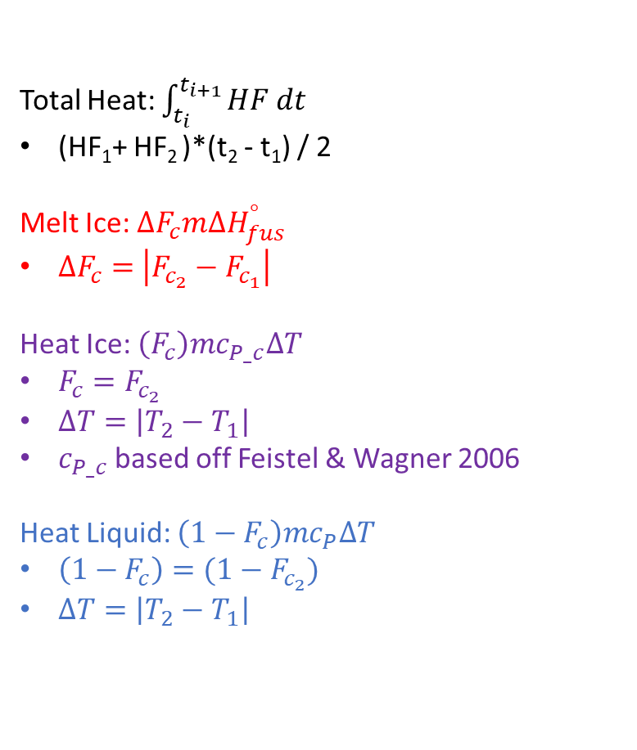
Specific Heat Retrieval
Total Heat: $\int_{t_{i}}^{t_{i+1}}{HF dt}$
(HF₁+ HF₂ )*(t₂ - t₁) / 2
Melt Ice: $∆F_{c}m{∆H}_{fus}^{°}$
$∆F_{c}=$ $\left|F_{c_{2}}−F_{c_{1}}\right|$
Heat Ice: $\left(F_{c}\right)mc_{P_c}∆T$
$F_{c}=F_{c_{2}}$
$∆T=\left|T_{2}−T_{1}\right|$
$c_{P_c}$based off Feistel & Wagner 2006
Heat Liquid: $\left(1−F_{c}\right)mc_{P}∆T$
$\left(1−F_{c}\right)=(1−F_{c_{2}})$
$∆T=\left|T_{2}−T_{1}\right|$
HF
(HF₁, t₁, T₁, Fc₁,)
(HF₂, t₂, T₂, Fc₂)
t

Slide 7
Experiments to run
16-19Aug → 8 wt%
22-25Aug → 1.76 wt%
26-29Aug → 3.52 wt%
30-2Sep → 6 wt%
5-8Sep → 10 wt%
We stick with 1.76 wt% and 3.52 wt% for easy comparison with previous runs.

